Slide 1



UVMMU: Hardware-Offloaded Page Migration for Heterogeneous Computing
Jihun Park, Donghun Jeong, and Jungrae Kim

Slide 2
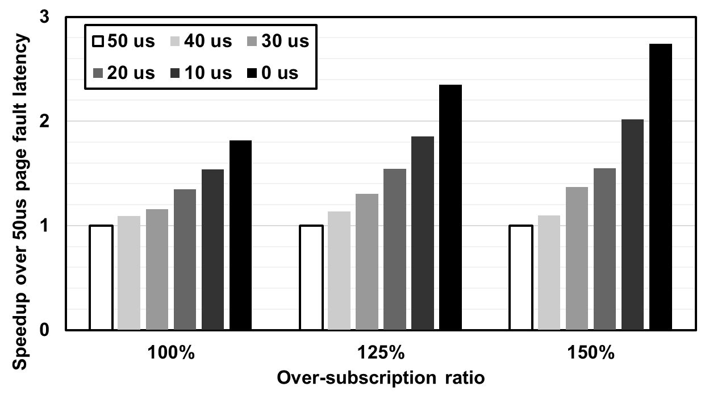
Introduction
Fault-based Page Migration Process
Impact of Page Fault
GPU
Page Fault
Computation
PCIe
Page migration
CPU
Page Fault Handling
time
45us
GPU driver raises SW interrupt (Page Fault).
CPU handles page faults to prepare page migration.
Page is migrated through PCIe.
Zero page fault latency leads up to 2.74x speedup.
But, Practical lower bound of page fault latency is 20us.
Need low-cost HW solution!

Slide 3
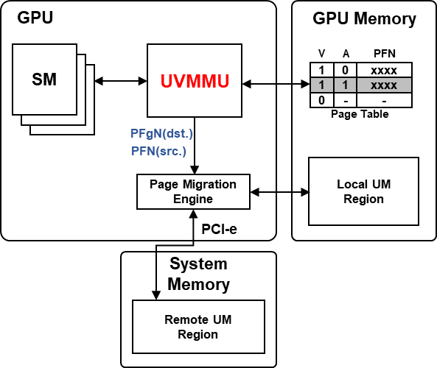
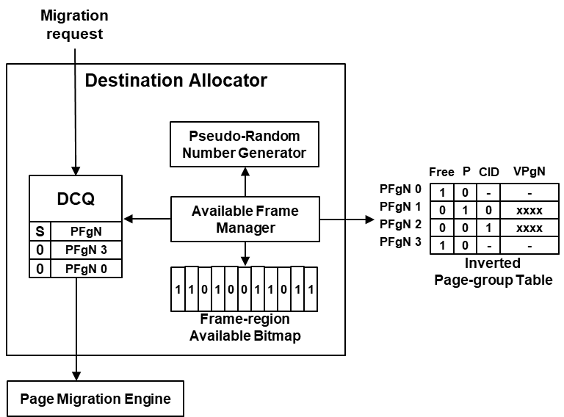
UVMMU
Overview
Hardware details
DCQ stores destination frame-group candidates entry for page migration.
Available Frame Manager find free frame-groups to fill DCQ with.
In over-subscription, fill DCQ with random frame-group.
UVMMU replaces GMMU to manage fast page migration preparation.
Provide destination/source frame addresses required for page migration.

Slide 4
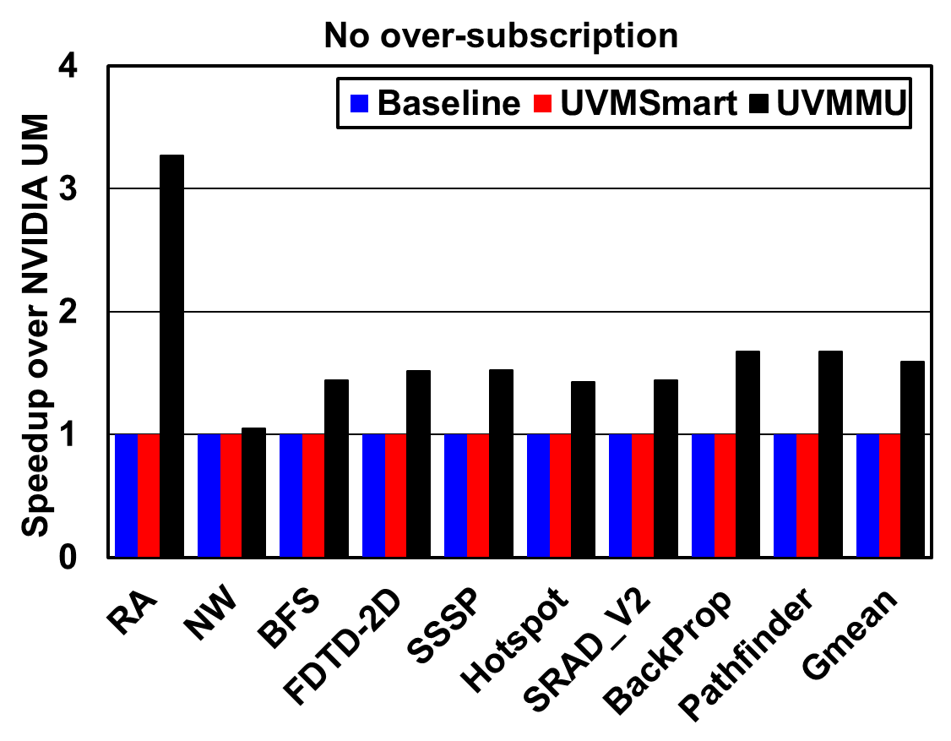
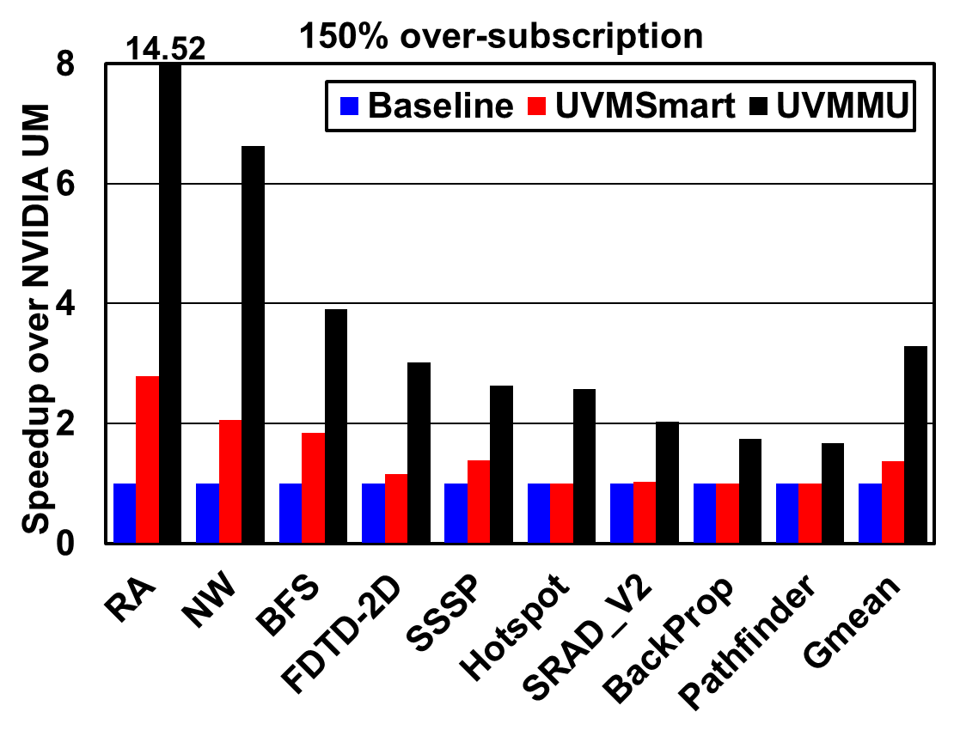
Results
Without Over-subscription
With Over-subscription
59.3% speedup over fault-based solution.
Large page fault handling delay (45us) is eliminated.
2.40x speedup in 150% over-subscription.
Page eviction increases costly page faults in fault-based solution.
UVMMU reduces page migration overhead!

Slide 5
Thank You

Slide 6
Background
Heterogeneous Computing System
Heterogeneous System
CPU
GPU
PCIe
CPU
Memory
GPU
Memory
Need user-responsible data copy
Data size is limited by GPU memory capacity
Need data partitioning tasks

Slide 7
Background
Unified Memory System
Programmer’s View
CPU
GPU
PCIe
Shared Address Space
CPU
Memory
GPU
Memory
Page Migration
Shared virtual address space among processors
On-demand page migration during kernel execution
Enable memory over-subscription
High programmability

Slide 8
Background
Fault-based Page Migration
Fault-based Page Migration Process
GPU
Page Fault
Computation
PCIe
Page migration
CPU
Page Fault Handling
time
45us
GPU driver raises SW interrupt (Page Fault).
CPU handles page faults to prepare page migration.
Page is migrated through PCIe.

Slide 9
Motivation
Impact of Page Fault Latency
Zero page fault latency leads up to 2.74x speedup.
But, Practical lower bound of page fault latency is 20us.
Need low-cost HW solution!

Slide 10
UVMMU
Overview
Goal: Offload page migration entirely to the HW
UVMMU replaces GMMU
Provide destination/source frame addresses required for page migration
Search and prepare destination frame address in background
Source frame address is stored in GPU page table

Slide 11
UVMMU
Data Structure
Inverted Page-group Table (IPgT)
Map of physical address to virtual address
Identify free frame-groups by ‘free’ flag
Frame-region Available Bitmap (FrAB)
Help faster free frame-group search
Identify free frame-group’s existence in 2MB frame-region

Slide 12
UVMMU
Hardware Details
DCQ
Store destination frame-group candidates
Entry is used for page migration
Available Frame Manager
Search FrAB and IPgT to find free frame-group
Fill DCQ with free frame-group
In over-subscription, fill DCQ with random frame-group

Slide 13
Evaluation
Methodology
Simulator: UVMSmart(Extended GPGPU-sim)
Add UM implementation
Replace GMMU with UVMMU
Add PCIe modeling
NVIDIA GTX 1080 Ti Configuration
Core | 1481MHz, 28 SMs, 64 warps/SM
Cache Line | 128B Line with 4 sectors(32B)
L1 Cache | 48KB, 6 Way Associative
L2 Cache | 3MB, 16 Way Associative
L1 TLB | 128 entries Fully Associative
Memory | 11GB 484GB/s GDDR5X
Page Table Walker | 64 walkers
PCIe | PCIe 3.0 x16(16GB/s BW, 1us RTT)
Migration Handling Latency | 10 cycle (UVMMU), 45us (Baseline)

Slide 14
Evaluation
Execution Time
Without Over-subscription
59.3% speedup over fault-based solution.
Large page fault handling delay (45us) is eliminated.

Slide 15
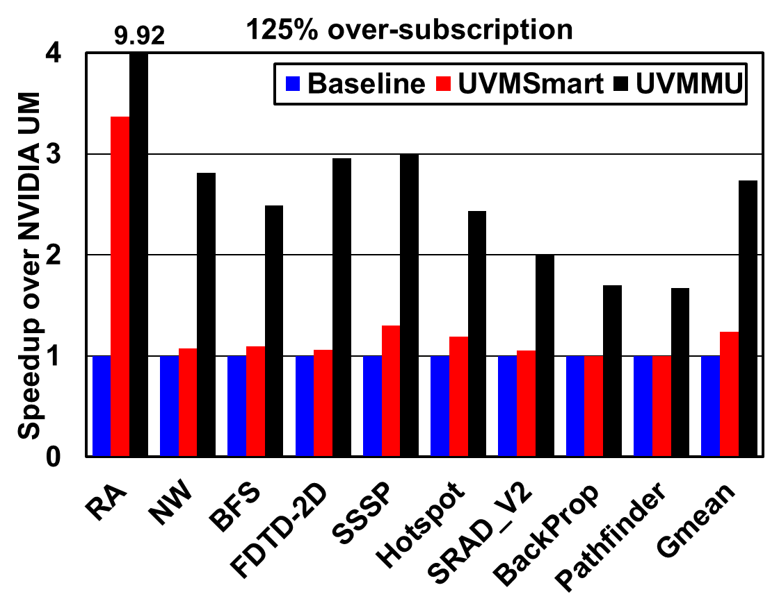
Evaluation
Execution Time
With Over-subscription
Result shows even larger performance gap.
2.21x and 2.40x speedup in 125% and 150% over-subscription.
Page eviction increases costly page faults in fault-based solution.

Slide 16
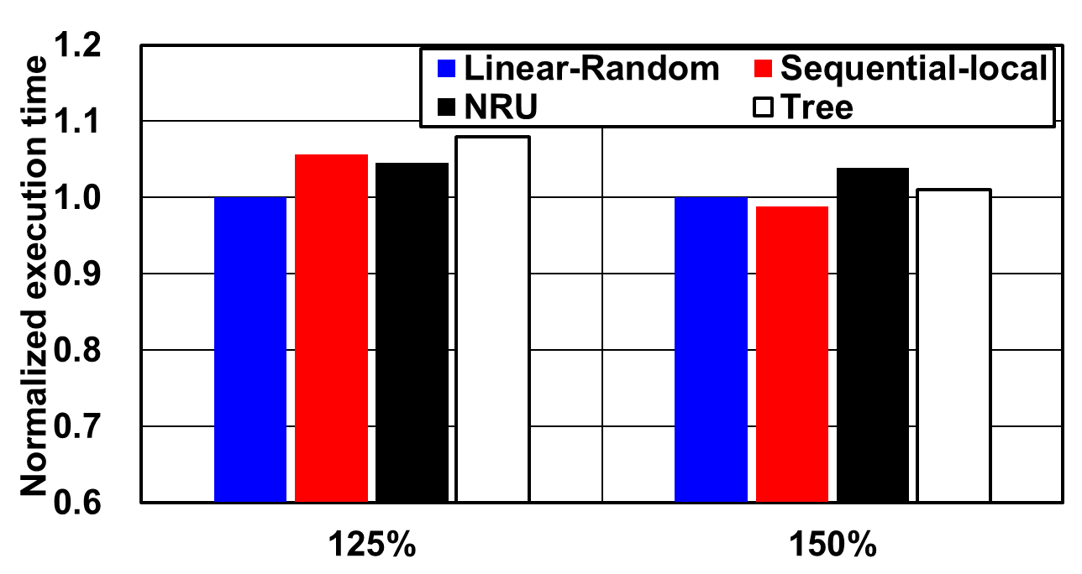
Evaluation
Sensitivity Studies
Eviction Policy
UVMMU utilizes Linear-Random policy for simple HW implementation.
Competitive performance compared to other policies.
UVMMU is insensitive to eviction policy due to low migration cost.

Slide 17
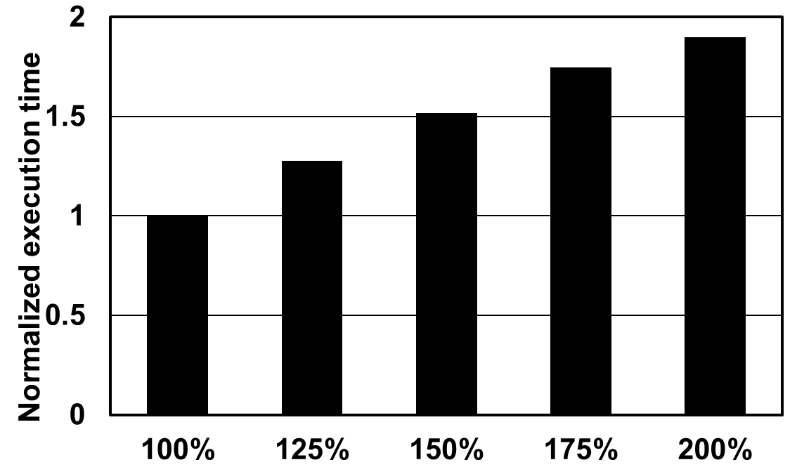
Evaluation
Sensitivity Studies
Over-subscription Ratio
UVMMU shows linear increase of execution time.
Fault-based solution shows rapid growth (e.g., 2.27x for 150%).
UVMMU exploits memory over-subscription with fewer overheads.

Slide 18
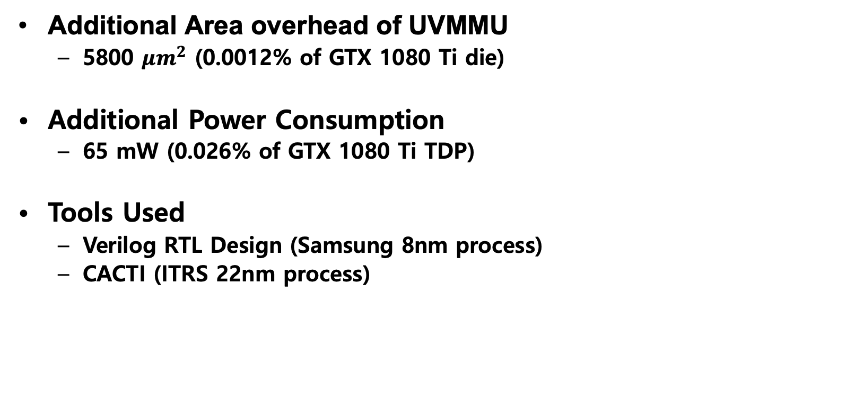
Evaluation
Hardware overhead
Additional Area overhead of UVMMU
5800 $μm^{2}$ (0.0012% of GTX 1080 Ti die)
Additional Power Consumption
65 mW (0.026% of GTX 1080 Ti TDP)
Tools Used
Verilog RTL Design (Samsung 8nm process)
CACTI (ITRS 22nm process)

Slide 19
Conclusion
UVMMU reduces page migration overhead!
GPU
Page Fault
Computation
PCIe
Page migration
CPU
Page Fault Handling
time
Fault-based Page Migration
GPU
H/W
Prep.
Computation
PCIe
Page migration
CPU
time
UVMMU

